Slide 1
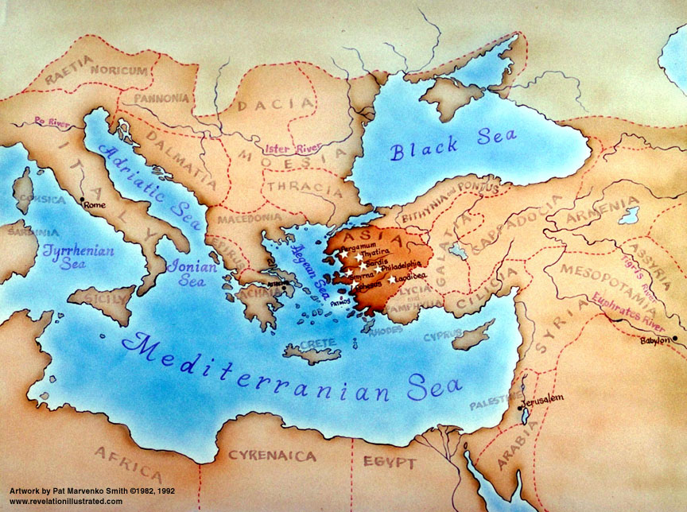
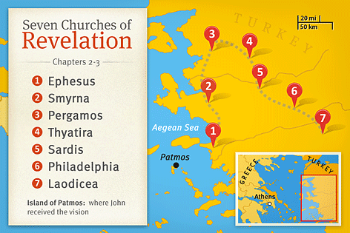

Slide 2
Revelation 2:8-11

Slide 3
⁸ “And to the angel of the church in Smyrna write: ‘The words of the first and the last, who died and came to life.
⁹ “ ‘I know your tribulation and your poverty (but you are rich) and the slander of those who say that they are Jews and are not, but are a synagogue of Satan. ¹⁰ Do not fear what you are about to suffer. Behold, the devil is about to throw some of you into prison, that you may be tested, and for ten days you will have tribulation. Be faithful unto death, and I will give you the crown of life. ¹¹ He who has an ear, let him hear what the Spirit says to the churches. The one who conquers will not be hurt by the second death.’

Slide 4
The Smyrna Church – Preparing for the Persecution
Prepare by increasing our faith (not about being brave)
Standing firm on the eternal promises of God
Jesus is the king of history. Nothing will happen to his disciples that He does not allow
Resurrection – those who die for their faith gain eternal life
They were suffering at the hands of the Romans (for refusing to worship Caesar). Instigated by the Jews.
Christian persecution is an attack of the Devil
Economic Oppression – no business; no job; no future
Rich in Spiritual currency (faith; love; grace; faithfulness)
Do not fear – You are about to suffer. Some will die
You die.... But you win!! (The victors crown – eternal life)
Will not be hurt by “the second death” – Hell
Truly know that Jesus has saved us from death and torment

Slide 5
Preparing for the Persecution
Do not fear – You are about to suffer. Some will die
Persecutions against Christians will Increase
Being prepared begins now:
A commitment of faith – There is nothing more important to me than Jesus Christ (not even life itself)
Live faithfully for Him now
Experience the faithfulness of God to us.
How could we ever deny Him

